Slide 1
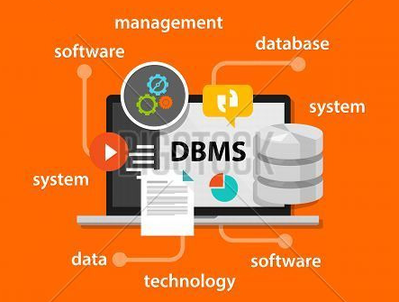

Unit – 1 Introductory concepts of DBMS
Prof. Firoz Sherasiya
 9879879861
→ firoz.sherasiya@darshan.ac.in
Database Management System (2130703) Darshan Institute of Engineering & Technology

Slide 2
Topics to be covered
Introduction of DBMS
Applications of DBMS
Advantages of DBMS
Three levels ANSI SPARC database system
Mappings and data independence
Database users and DBA
Database system architecture

Slide 3
What is Database Management System (DBMS)?
Data - Fact that can be recorded or stored
e.g. Person Name, Age, Gender and Weight etc.
Database - Collection of logically related data
e.g. Books Database in Library, Student Database in University etc.
Management - Manipulation, Searching and Security of data
e.g. Viewing result in GTU website, Searching exam papers in GTU website
System - Programs or tools used to manage database
e.g. SQL Server Studio Express, Oracle
DBMS - A Database Management System is a software for creating and managing databases.
Database Management System (DBMS) is a software designed to define, manipulate, retrieve and manage data in a database.
e.g. MS SQL Server, Oracle, My SQL, SQLite, MongoDB etc.

Slide 4
Applications
of
DBMS

Slide 5
Applications of DBMS
DBMS is a computerized record-keeping system.
DBMS is required where ever data need to be stored.
E-Commerce (Flikart, Amazon, Shopclues, eBay etc.)
Online Television Streaming (Hotstar, Amazon Prime etc.)
Social Media (WhatsApp, Facebook, Twitter, LinkedIn etc.)
Banking & Insurance
Airline & Railway
Universities and Colleges/Schools
Human Resource Department
Hospitals and Medical Stores
Government Organizations

Slide 6

Exercise
Write down any five applications of DBMS other than the previous slide.

Slide 7
Advantages
of
DBMS

Slide 8

Reduce data redundancy (duplication)
Computer
Civil
Emp_Name | Address | Mob | Subject
Emp_Name | Address | Mob | Subject
Prof. Ajay Shah | Rajkot | 1234 | CPU
Prof. Ajay Shah | Rajkot | 1234 | CPU
Database management system can remove such data redundancy by storing data centrally.
Same data is stored at
four different places.
Emp_Name | Address | Mob | Subject
Emp_Name | Address | Mob | Subject
Prof. Ajay Shah | Rajkot | 1234 | CPU
Prof. Ajay Shah | Rajkot | 1234 | CPU
Electrical
Mechanical

Slide 9
Remove data inconsistency
Computer
Civil
Emp_Name | Address | Mob | Subject
Emp_Name | Address | Mob | Subject
Prof. Ajay Shah | Rajkot | 1234 | CPU
Prof. Ajay Shah | Rajkot | 1234 | CPU
6789
Database management system can keep data in consistent state.
Same data having
different state (values)
Mobile no is changed
Emp_Name | Address | Mob | Subject
Emp_Name | Address | Mob | Subject
6789
Prof. Ajay Shah | Rajkot | 1234 | CPU
Prof. Ajay Shah | Rajkot | 1234 | CPU
Electrical
Mechanical

Slide 10
Data Isolation
Data are scattered in various files
Files may be in different formats
Difficult to retrieve the appropriate data
File 1
Emp_Name | Address | Mob | Subject
Prof. Ajay Shah | Rajkot | 1234 | CPU
File 2
Emp_Name | Salary | Load
Prof. Ajay Shah | 50000 | 20
File 3
Emp_Name | Teaching | Knowledge | Rating
Prof. Ajay Shah | Good | V. Good | 9
DBMS allow us to access (retrieve) appropriate data easily.

Slide 11


Guaranteed Atomicity
Either transaction execute 0% or 100%.
Sum of both account before transfer is 3000
Person A
Account A
Bal : 2000
Transfer 500
Person B
Account B
Bal : 1000
Step 1 : Debit 500 from Account A
Step 2 : Credit 500 into Account B
Transaction is failed
Sum of both account is 2500
so inconsistent
Sum of both account
after transfer is 3000

Slide 12
Allow to implement integrity constraints
Emp_Name | Address | Mobile | Subject
Prof. Ajay Shah | Rajkot | 9825598255 | CPU
Should contain exact 10 digits
Stu_Name | Branch | Backlogs | SPI
Nirav Patel | C.E. | 8 | 2.5
Should be between 0 to 10
DBMS allows us to implement such business rules in our database.

Slide 13

Sharing of data among multiple users
Want to access
Computer
Civil
Emp_Name | Address | Mob | Subject
Emp_Name | Address | Mob | Subject
Prof. Ajay Shah | Rajkot | 1234 | CPU
Prof. Ajay Shah | Rajkot | 1234 | CPU
Database management system allows more than one user to access same data simultaneously.
Want to access
Emp_Name | Address | Mob | Subject
Emp_Name | Address | Mob | Subject
Prof. Ajay Shah | Rajkot | 1234 | CPU
Prof. Ajay Shah | Rajkot | 1234 | CPU
Electrical
Mechanical

Slide 14

Restricting unauthorized access to data
Emp_Name | Address | Mob | Subject
Wants to access
Prof. Ajay Shah | Rajkot | 1234 | CPU
Faculty of other college
Emp_Name | Salary | Load
Prof. Ajay Shah | 50000 | 20
Wants to access
Darshan Faculty
Emp_Name | Teaching | Knowledge | Rating
Prof. Ajay Shah | Good | V. Good | 9
DBMS prevents unauthorized user to access data.

Slide 15
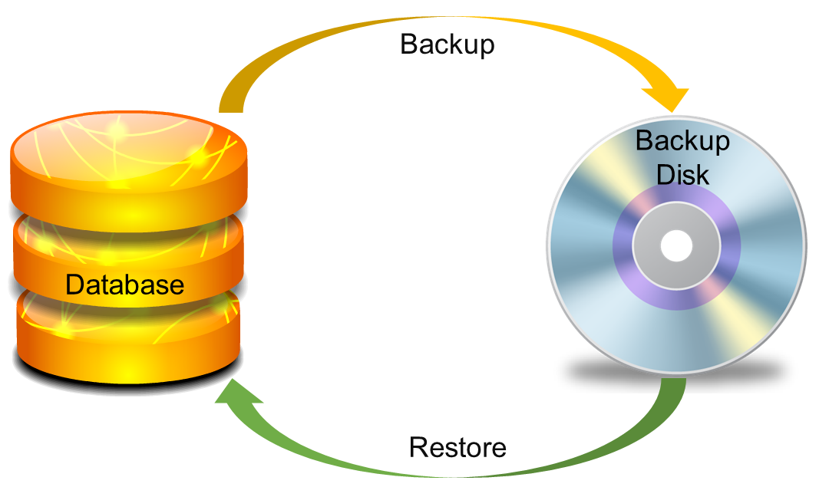
Providing backup and recovery services
Provides facilities to backup and restore the database in case of failure.

Slide 16
Advantages of DBMS (Summary)
Reduce data redundancy (duplication)
Avoids unnecessary duplication of data by storing data centrally.
Remove data inconsistency
By eliminating redundancy, data inconsistency can be removed.
Data isolation
A user can easily retrieve proper data as per his/her requirement.
Guaranteed atomicity
Either transaction executes 0% or 100%.

Slide 17
Advantages of DBMS (Summary)
Allow implementing integrity constraints
Business rules can be implemented such as do not allow to store amount less than Rs. 0 in balance.
Sharing of data among multiple users
More than one users can access same data at the same time.
Restricting unauthorized access to data
A user can only access data which is authorized to him/her.
Providing backup and recovery services
Can take a regular auto or manual backup and use it to restore the database if it corrupts.

Slide 18
Basic Terms
Data
Data is raw, unorganized facts that need to be processed.
Example: Marks of students
Student_1 = 50/100, Student_2 = 25/100.
Information
When data is processed, organized, structured or presented in a given context so as to make it useful, it is called information.
Example: Result of students (Pass or Fail)
Student_1 = Pass, Student_2 = Fail.

Slide 19
Basic Terms (cont…)
Metadata
Metadata is data about data.
Data such as table name, column name, data type, authorized user and user access privileges for any table is called metadata for that table.
Metadata of above table is:
Table name such as Faculty
Column name such as Emp_Name, Address, Mob, Subject
Datatype such as Varchar, Decimal
Access privileges such as Read, Write (Update)
Faculty
Emp_Name | Address | Mob | Subject
Prof. Ajay Shah | Rajkot | 1234 | CPU
Prof. Om Patel | Rajkot | 6789 | DBMS

Slide 20
Basic Terms (cont…)
Data dictionary
A data dictionary is an information repository which contains metadata.
Data warehouse
A data warehouse is an information repository which stores data.
Table Name – Faculty
Column Name – EmpName, Address, Mob, Subject, Salary
Datatype – Varchar, Decimal
Access Privileges – Read, Write (Update)
Faculty
Emp_Name | Address | Mob | Subject
Prof. Ajay Shah | Rajkot | 1234 | CPU
Prof. Om Patel | Rajkot | 6789 | DBMS

Slide 21
Exercise
Why data dictionary and data warehouse are stored in the different places?

Slide 22
Basic Terms (cont…)
Field
A field is a character or group of characters that have a specific meaning.
E.g, the value of Emp_Name, Address, Mob etc are all fields for Faculty table.
Record / Tuple
A record is a collection of logically related fields.
E.g, the collection of fields (Emp_Name, Address, Mob, Subject & Salary) forms a record for the Faculty.
Fields
Faculty
Emp_Name | Address | Mob | Subject
Prof. Ajay Shah | Rajkot | 1234 | CPU
Prof. Ajay Shah
Prof. Om Patel | Rajkot | 6789 | DBMS
Rajkot
Record / Tuple
Prof. Ajay Shah | Rajkot | 1234 | CPU

Slide 23
Exercise
How many fields and records are there in the following table?
Faculty
Emp_Name | Address | Mob | Subject
Prof. Ajay Shah | Rajkot | 1234 | CPU
Prof. Om Patel | Rajkot | 6789 | DBMS
Prof. Jay Mehta | Baroda | 4567 | DS
Prof. Neel Jha | Surat | 7890 | CPP

Slide 24
3 Levels
ANSI SPARC Database System

Slide 25

3 Levels ANSI SPARC Database System
User 1
User 2
User 3
How data are viewed by each users?
View 1
View 2
View 3
View
Level
What data are stored and
What relationships exist?
Conceptual
Level
Logical
Level
How the data are actually stored on storage devices?
Internal
Level
Physical
Level
Database

Slide 26
Internal level (Physical level)
It describes how a data is stored on the storage device.
Deals with physical storage of data.
Structure of records on disk - files, pages, blocks
Indexes and ordering of records
Internal view is described by the internal schema.

Slide 27
Conceptual level (Logical level)
What data are stored and what relationships exist among those data?
It hides low level complexities of physical storage.
For Example, STUDENT database may contain STUDENT and COURSE tables which will be visible to users but users are unaware about their storage.
Database administrator works at this level to determine what data to keep in the database.

Slide 28
External level (View level)
It describes only part of the entire database that an end user concern or How data are viewed by each user.
End users need to access only part of the database rather than the entire database.
Different user needs different views of the database, so there can be many views in a view level abstraction of the database.
Used by end users and application programmers.

Slide 29
Mapping
Want to access some data
User 1
User 2
User 3
View 1
View 2
View 3
View
Level
Request
Conceptual
Level
Logical
Level
Process of transforming requests and results between the three levels is called mapping.
Internal
Level
Physical
Level
Result
Database

Slide 30
Data Independence
User 1
User 2
User 3
View 1
View 2
View 3
View
Level
Conceptual
Level
Logical
Level
Ability to modify a schema definition in one level without affecting a schema definition in the next higher level.
Internal
Level
Physical
Level
Database

Slide 31
Types of Data Independence
Physical Data Independence
Logical Data Independence

Slide 32
Physical Data Independence
Physical Data Independence is the ability to modify the physical schema without requiring any change in logical (conceptual) schema and application programs.
Modifications at the internal levels are occasionally necessary to improve performance.
Possible modifications at internal levels are changes in file structures, compression techniques, hashing algorithms, storage devices, etc.

Slide 33
Logical Data Independence
Logical data independence is the ability to modify the conceptual schema without requiring any change in application programs.
Modification at the logical levels is necessary whenever the logical structure of the database is changed.
Application programs are heavily dependent on logical structures of the data they access. So any change in logical structure also requires programs to change.

Slide 34
Instance and Schema
Instance
The collection of information stored in the database at particular moment is called instance.
Instances are changed frequently.
Schema
The overall design of database is called database schema.
Schemas are changed rarely.
Emp_Name Char(10) | Salary Int
Schema
Prof. Ajay Shah | 15000
Instance
Prof. Om Patel | 10000

Slide 35
Types of database users
Naive Users (End Users)
Unsophisticated users who have zero knowledge of database system
End user interacts to database via sophisticated software or tools
e.g. Clerk in bank
Application Programmers
Programmers who write software using tools such as Java, .Net, PHP etc…
e.g. Software developers

Slide 36
Types of database users
Sophisticated Users
Interact with database system without using an application program
Use query tools like SQL
e.g. Analyst
Specialized Users (DBA)
User write specialized database applications program
Use administration tools
e.g. Database Administrator

Slide 37
Role of DBA (Database Administrator)
Schema Definition
DBA defines the logical schema of the database.
Storage Structure and Access Method Definition
DBA decides how the data is to be represented in the database & how to access it.
Defining Security and Integrity Constraints
DBA decides on various security and integrity constraints.
Granting of Authorization for Data Access
DBA determines which user needs access to which part of the database.

Slide 38
Role of DBA (Database Administrator)
Liaison with Users
DBA provide necessary data to the user.
Assisting Application Programmer
DBA provides assistance to application programmers to develop application programs.
Monitoring Performance
DBA ensures that better performance is maintained by making a change in the physical or logical schema if required.
Backup and Recovery
DBA backing up the database on some storage devices such as DVD, CD or magnetic tape or remote servers and recover the system in case of failures, such as flood or virus attack from this backup.

Slide 39
Database System Architecture
Naive
user
Application programmer
Sophisticated
user
Database administrator
uses
write
uses
uses
Application
interfaces
Application
program
Query
tool
Administration tool
Translates DML statements into low level instructions that the query evaluation engine understands
Compiler and linker
DML queries
DDL interpreter
Interprets DDL statements into a set of tables containing metadata
Executes low level instructions generated by DML compiler.
Deals with execution of DDL and DML statements
Application program object code
DML compiler and organizer
Query evaluation engine
Query processor
Buffer manager
File manager
Authorization and integrity manager
Transaction manager
Manages allocation of space on disk storage
Storage manager
Fetches data from disk storage to memory for being used
Preserves atomicity and controls concurrency
Provides interface between low-level data stored and application program or queries
Checks the authority of users to access data and integrity constraints
To provide faster access to data items
Indices
Data dictionary
Disk storage
To store user data
Data
Statistical data
To store statistical information about the data
To store metadata

Slide 40
Questions asked in GTU
List and explain the advantages of DBMS.
Draw and explain 3 level architecture of DBMS.
List and explain categories of database users.
List and explain different tasks of DBA.
Explain DBMS architecture with block diagram.

